Slide 1



Heart Disease Dataset Preprocessing
PROJECT MEMBERS :
Mownisha A (23ITR104)
Mohitha Shree S (23ITR101)
Jagadheesh J (23ITR064)

Slide 2

The heart disease dataset faces several issues that impact analysis:
Missing Values: Incomplete records affecting data quality.
Outliers: Extreme values skewing results.
Categorical Variables: Need conversion for modeling.
Effective preprocessing is essential to clean and prepare the data for accurate machine learning prediction.

Slide 3
Objectives
To preprocess the dataset by handling missing values, out layers, and categorical data and ensuring it is clean and suitable for effective machine learning modeling.
3

Slide 4
Software Tools used
Editor : Colab
Programming Language: Python
Data Manipulation : Pandas
Numerical Operation : NumPy
Data Visualization : Matplotlib/ Seaborn
4

Slide 5
Implementation Details
Data Collection and Preprocessing : Load the dataset to colab environment
Data Exploration and Understanding : Perform exploratory data analysis (EDA) to understand the structure and characteristics of the data.
Data Cleaning : Handle missing values and clean up the data.
Handling Outliers : Identify and treat outliers in the data.
Splitting the data : Split the dataset into training and testing sets.
Visualisation and Reporting : Visualize and report the preprocessing steps and their impact.

Slide 6
Modules
Data Cleaning
Scaling and Normalization
Encoding Categorical Variables
Handling Imbalanced Data
Data Splitting

Slide 7
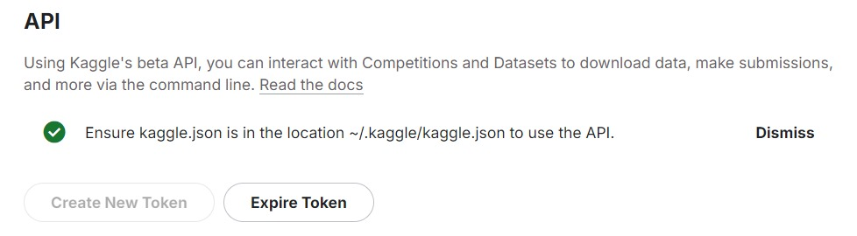

Slide 8
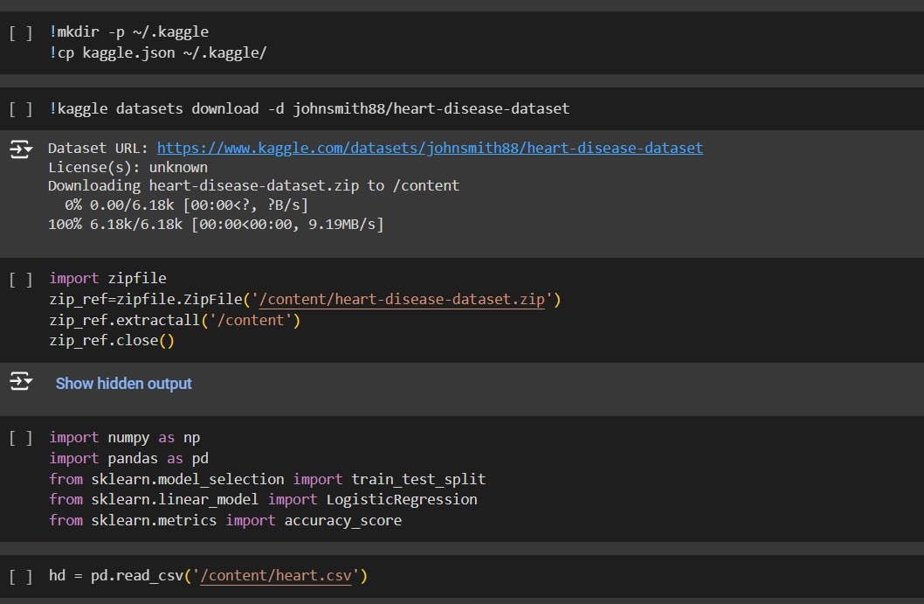

Slide 9
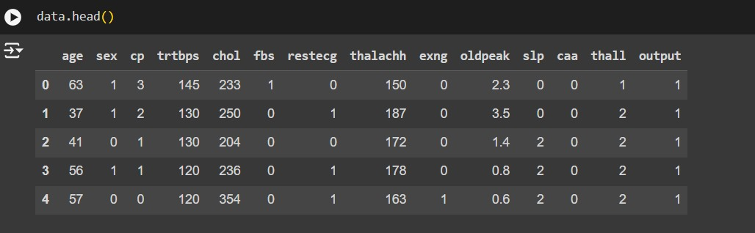

Slide 10
Reference:
Sample project for reference:
https://colab.research.google.com/drive/1vvqCuKsvwKvnyChLh5zM4V23k46SamC5?usp=sharing
Geeks for Geeks python reference:
https://www.geeksforgeeks.org/python-programming-language-tutorial/
Kaggle for dataset:
https://www.kaggle.com/code/desalegngeb/heart-disease-predictions
Python Machine Learning:​
https://www.w3schools.com/python/python_ml_getting_started.asp​

Slide 11
Thank you!

